Slide 1
RECURSIVE BINARY SEARCH: ALGORITHM, EXAMPLE & TIME COMPLEXITY ANALYSIS
Presented By:
MEENAKSHI SARKAR : University Roll No – 21301221088
PURTI KOCHAR : University Roll No – 21301221081
ANKIT ROY : University Roll No – 21301221085
THE HERITAGE ACADEMY
10TH AUGUST 2023

Slide 2
INTRODUCTION
Binary Search is the search technique that works efficiently on sorted lists. Hence, to search an element into some list using the binary search technique, we must ensure that the list is sorted.
Recursive Binary Search is an implementation of the binary search algorithm that uses recursive method calls (instead of iteratively searching for the item within a single method call). [1]

Slide 3
THE ALGORITHM
Algorithm recursive_binary_search(arr, x, low, high):
{
if low <= high:
mid = (low + high) // 2
if arr[mid] == x:
return mid # Target found at index mid
else if arr[mid] < x:
return recursive_binary_search(arr, target, mid + 1, high) # Search in the right half
else:
return recursive_binary_search(arr, target, low, mid - 1) # Search in the left half
else:
return -1 # Target not found
}

Slide 4
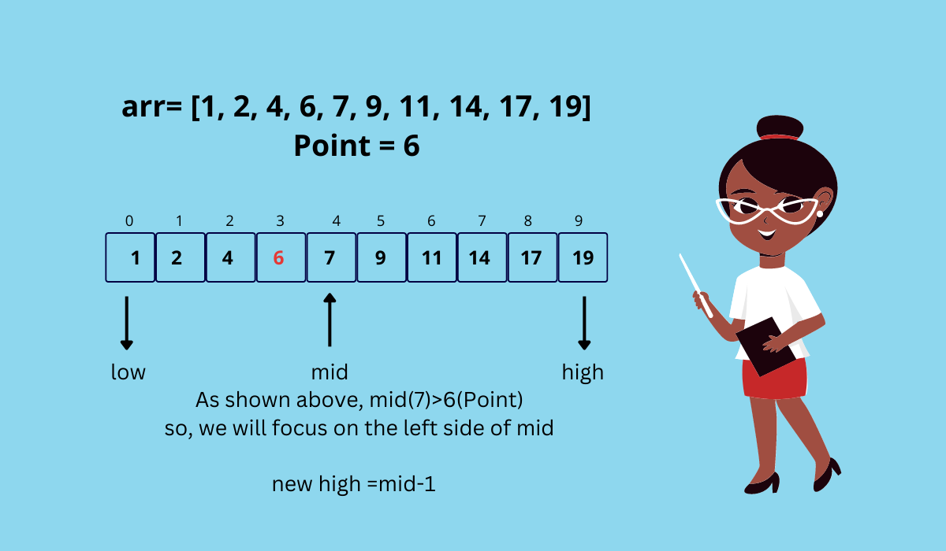
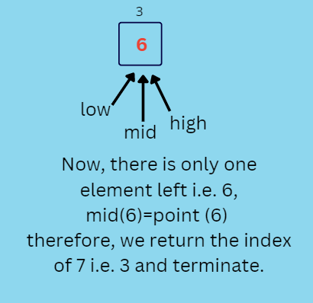
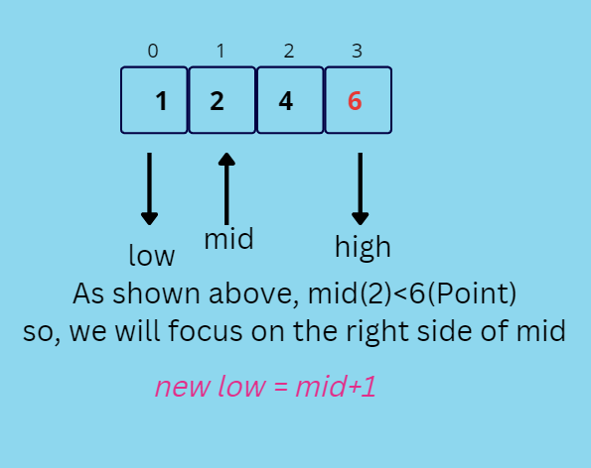
EXAMPLE OF RECURSIVE BINARY SEARCH

Slide 5
TIME COMPLEXITY ANALYSIS
Best Case Time Complexity: O(1):
Best case is when the element is at the middle index of the array. It takes only one comparison to find the target element. So the best case complexity is O(1).
Average Case Time Complexity: O(log N):
The average complexity = (N*(logN – 1) + 1)/N+1 = N*logN / (N+1) + 1/(N+1). Here the dominant term is N*logN/(N+1) which is approximately logN. So the average case complexity is O(logN).
Worst Case Time Complexity: O(log N):
The worst case will be when the element is present in the first position. As seen in the average case, the comparison required to reach the first element is logN. Worst case may also occur if the value is at the last index of the array. So the time complexity for the worst case is O(logN).

Slide 6
Advantages of recursive binary search
Efficiency
Simple Implementation
Memory Efficiency
Optimal for Sorted Data
Divide and Conquer

Slide 7
DISADVANTAGES OF RECURSIVE BINARY SEARCH
Recursive Overhead
Implementation Complexity
Limited Applicability
Not Always Faster
Lack of Flexibility[2]

Slide 8
CONCLUSION
In conclusion, recursive binary search offers an efficient way to search for elements in sorted arrays, but it's important to consider the potential drawbacks, such as recursion overhead and limitations in applicability. Depending on the context and specific requirements of your task, you might choose to use binary search or explore other search algorithms that better match your needs.
The future of any algorithm's scope depends on technological advancements, emerging problem domains, and the needs of various industries. While recursive binary search is already a well-established technique, ongoing research and innovation could lead to exciting new applications and optimizations.[1]

Slide 9
References
https://www.techiedelight.com/binary-search/
https://www.chegg.com/homework-help/definitions/recursive-binary-search-3#:~:text=Recursive%20binary%20search%20is%20an,within%20a%20single%20method%20call).

Slide 10
THANK YOU

